Slide 1


System Analysis And Design (SAD)
Smita Bisht
Assistant Professor
School of Polytechnic

Slide 2
FILE ORGANISATION
Refers to the way in which records are stored in an external file
Refers to the data structures used for organizing the data.
File Organisation helps in making the records easily accessible for processing.
Other points to consider are:
  Storage Cost.
  Access requirement.
  File Privacy, Integrity, Security, Confidentiality

Slide 3
Objectives of file organisation
Storing the files in certain order is called file organization. The main objective of file organization is Optimal selection of records i.e.; records should be accessed as fast as possible.
Any insert, update or delete transaction on records should be easy, quick and should not harm other records.
No duplicate records should be induced as a result of insert, update or delete
Records should be stored efficiently so that cost of storage is minima.

Slide 4
TYPES OF FILE ORGANISATION
Serial.
Sequential.
Indexed Sequential.
Direct Access /Random Access.

Slide 5
SERIAL FILE ORGANISATION
In serial file organization, the file is created by placing one record after another.
The approach this design follows is that of reading one record after another.
Records cannot be inserted in between, they can only be added at the end of the file.
All records are stored by position.
In reading a serial file, the system always starts at the beginning of the file, and reads its way up to the record, one record at a time.

Slide 6
ADVANTAGES
Serial Files are simple to understand and design.
These files requires relatively inexpensive I/O media and devices.
Serial files are efficient and economical
DISADVANTAGES
Even for a single record, entire file must be processed.
Records cannot be added to the middle of the file.

Slide 7
SEQUENTIAL FILE ORGANISATION
In sequential file, records are arranged into ascending or descending order according to the key field.
The key field may be alphabetic, numeric or a combination of both.
This key is also known as Record key or Simply key
Suitable for the Master File.

Slide 8
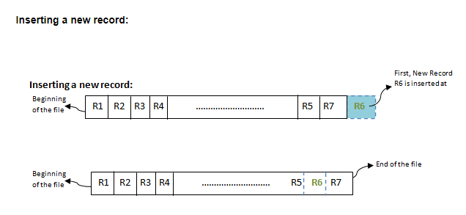

Slide 9
ADVANTAGES
These are very logical to design and understand.
This organisation is fairly efficient for a wide variety of application.
Supports very efficient programming.
DISADVANTAGES
Data redundancy is typically high since the same data may be stored in several files sequenced on different keys.

Slide 10
INDEXED SEQUENTIAL FILE ORGANISATION
Indexed sequential file organisation make use of an index for accessing records stored in the system.
Each record of a file has a key field which uniquely identifies that record.
An indexed sequential file is a sequential file (i.e. sorted into order of a key field) which has an index.
Using index search is faster, since it takes less time to search an index as compare to an entire file of data.

Slide 11
ADVANTAGES
Provides quick access to records in a relatively efficient way.
Records can be inserted or updated in the middle of the file.
These files are stored in magnetic tapes which are comparatively cheap.

Slide 12
DISADVANTAGES
It requires unique keys.
  Extra storage space for the index is required
It requires expensive hardware and software resources.
Sorted file method always involves the effort for sorting the record. Each time any insert/update/ delete transaction is performed, file is sorted. Hence identifying the record, inserting/ updating/ deleting the record, and then sorting them always takes some time and may make system slow

Slide 13
DIRECT ACCESS ORGANISATION
In direct file organisation, records are stored randomly in the file.
Records are not required to be in sequence because they are updated directly and rewritten back in the same place on the disk.
News records are added at the end of the file or inserted at specific locations based on software commands.
All records are stored by keys at address rather than by position.

Slide 14
Records are retrieved by addresses that indicate their disk locations.
An address is used for finding a record for linking records etc.
Addresses are of two types:
1) Absolute Address.
2) Relative Address.

Slide 15
ADVANTAGES
The time taken for searching the transactions can be minimized.
It is possible to update several files as a result of single transaction.
DISADVANTAGES
Insertion and Deletion of records is more difficult than with sequential file organisation.
Direct file organisation requires relatively expensive hardware and software.

